Slide 1
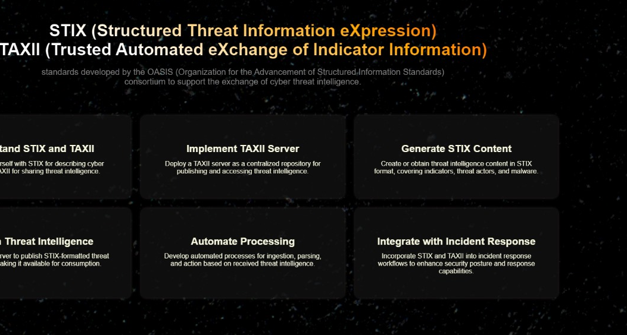
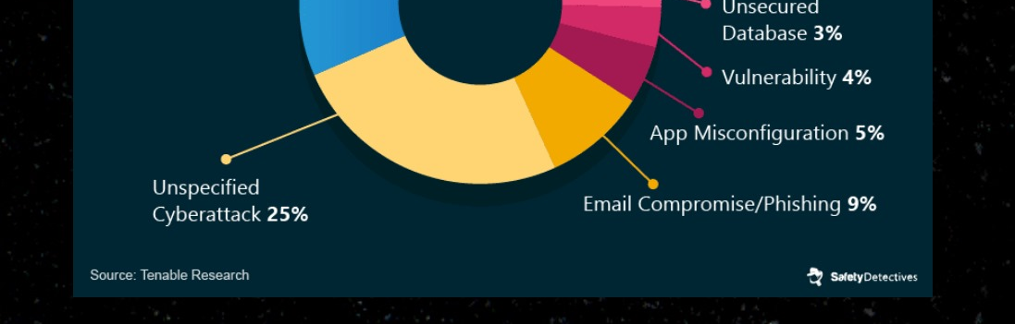

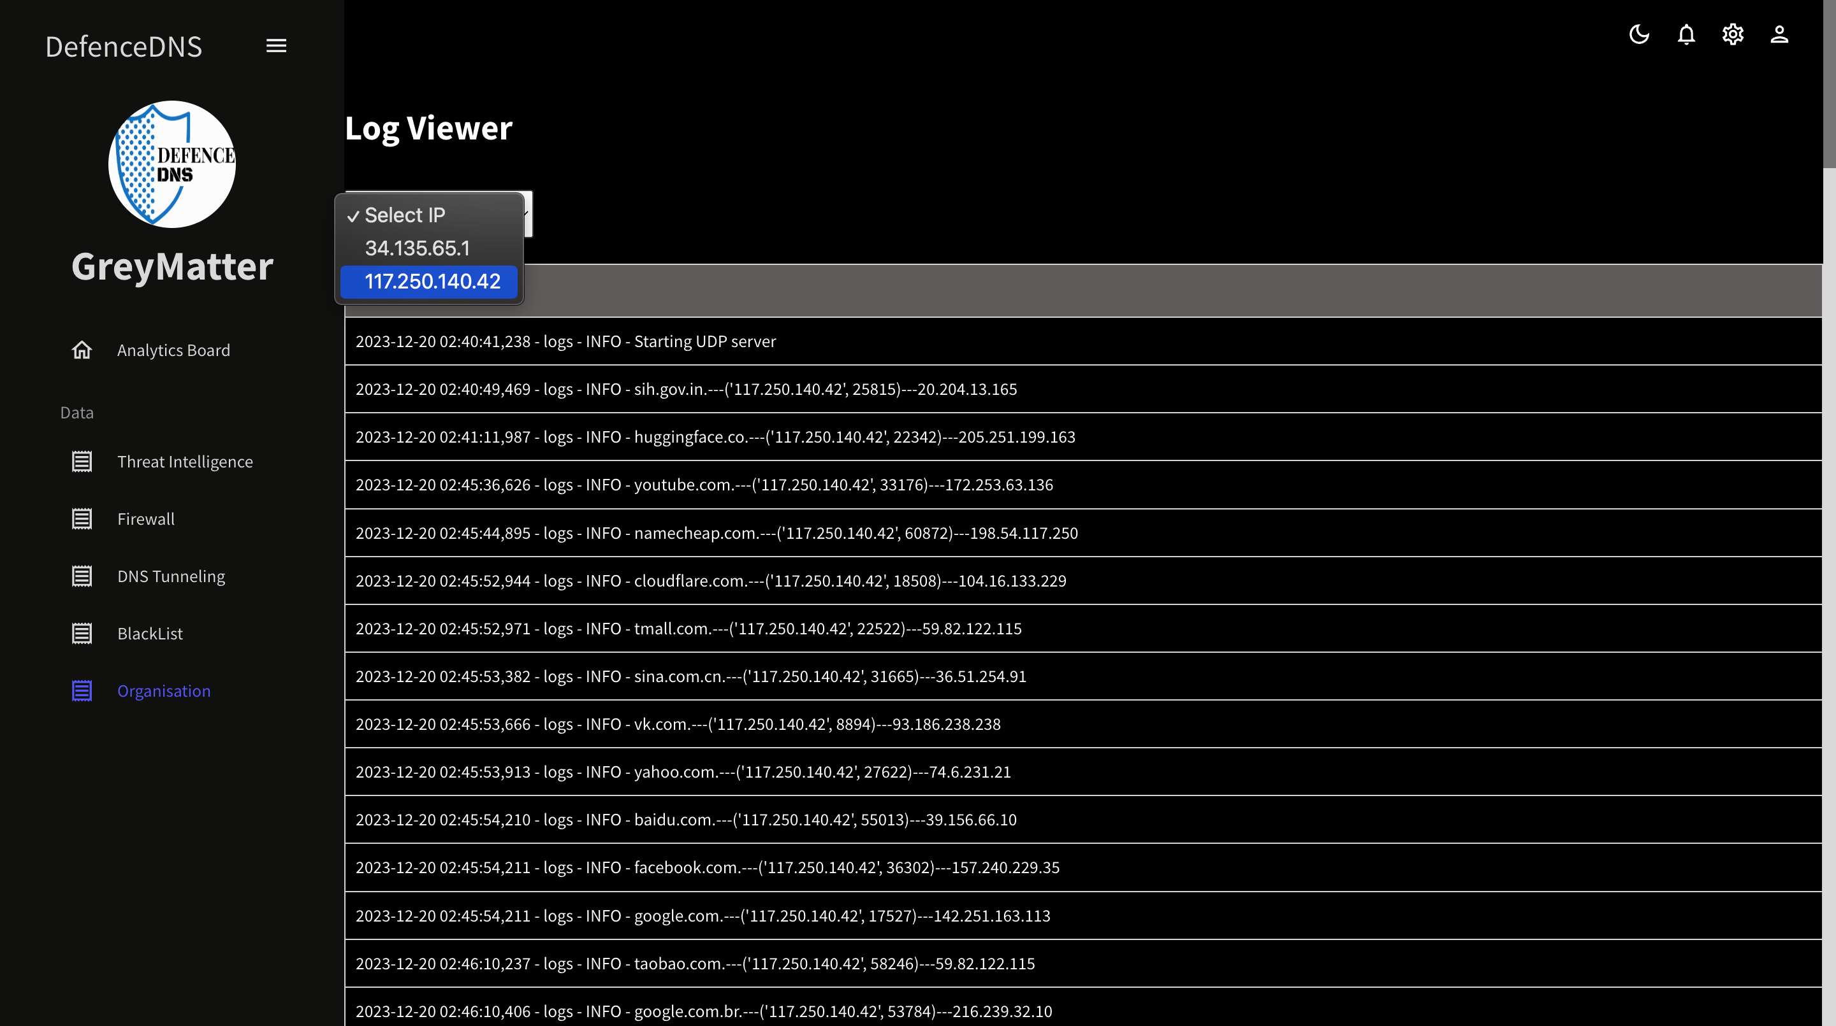
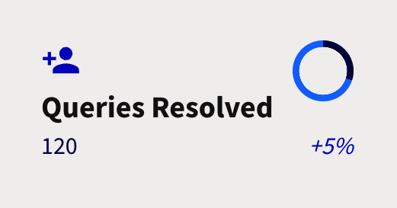
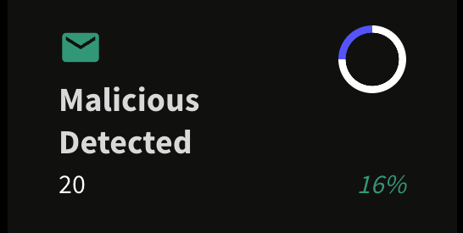
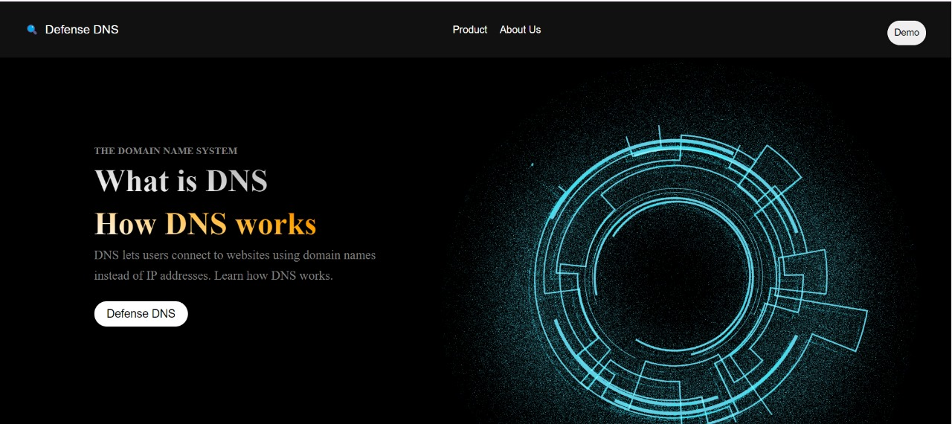
SIH 2023
GREYMATTER
DEFENSE DNS
PS 1524: DOMAIN NAME SERVICES (DNS) FILTERING SERVICE USING THREAT INTELLIGENCE FEEDS AND AI/ML TECHNIQUES

Slide 2
FEATURES
DNS-layer security
AVL implementation
Post Incident Analysis
LRU Caching
Domain generation Algorithm Detection ( Using Machine Learning)
Active Analysis of DNS Traffic as FireWall
Avg lookup time less than 60 ms

Slide 3
FEATURES
Our DNS resolver detects :
Malware
DGA
Phishing
Malicious Domains
Our global Competitors as We are the First in India
Google
Cloudfare
NextDNS

Slide 4
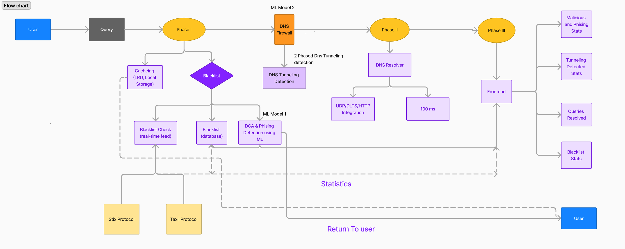
PROCESS FLOW
1
2
3
4
5
DNS Resolver
ML Models To
Detect DGA
DNS Tunneling
Stix-Taxii
Real Time Statistics

Slide 5
1
DNS RESOLVER
We are approaching DNS resolver in three steps :-
Blacklist (AVL Tree)
DGA & ML Detection
Caching

Slide 6
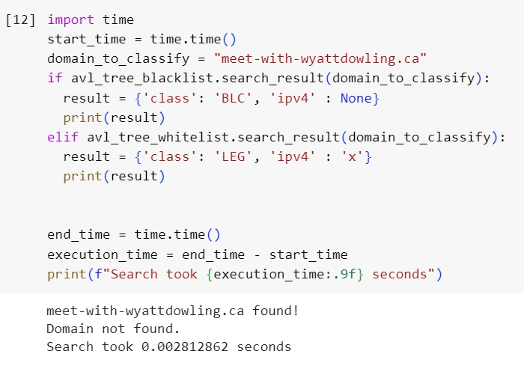
1
DNS RESOLVER
(i)
Implementation of Blacklist using AVL Tree
AVL Tree enables us to scale down the searching time in blacklist to a fraction of what it takes to search in a database.
AVL Tree takes just 2.812 ms to search.

Slide 7
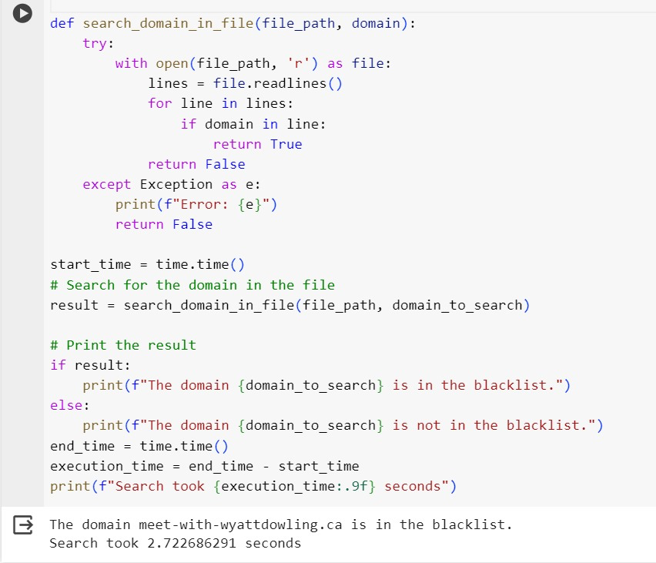
1
DNS RESOLVER
(i) Implementation of Blacklist using a normal database
Time taken to search in a blacklist using
Normal database is 2.722 seconds.

Slide 8
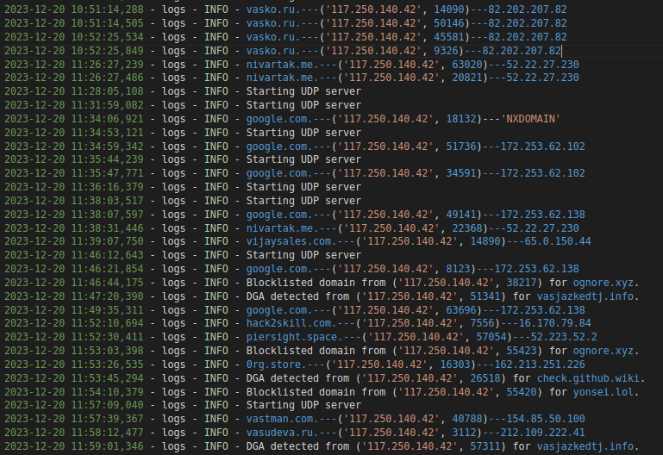
1
DNS RESOLVER

Slide 9
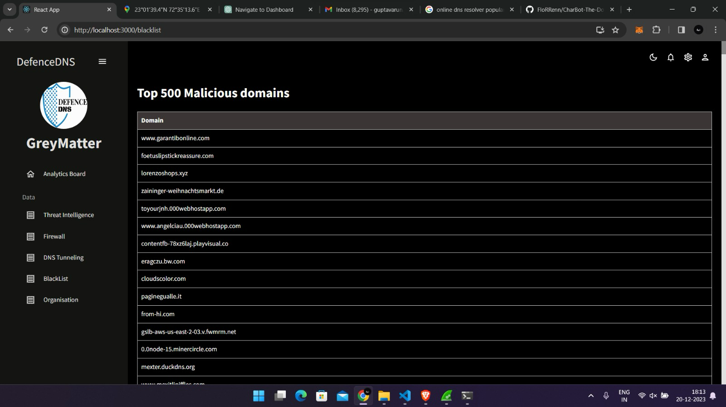
1
DNS RESOLVER

Slide 10
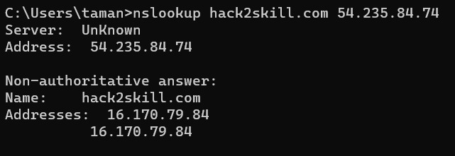
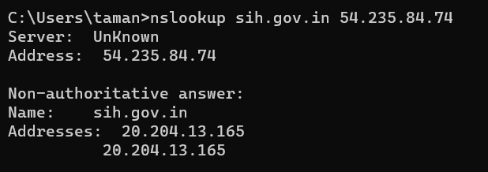
1
DNS RESOLVER

Slide 11
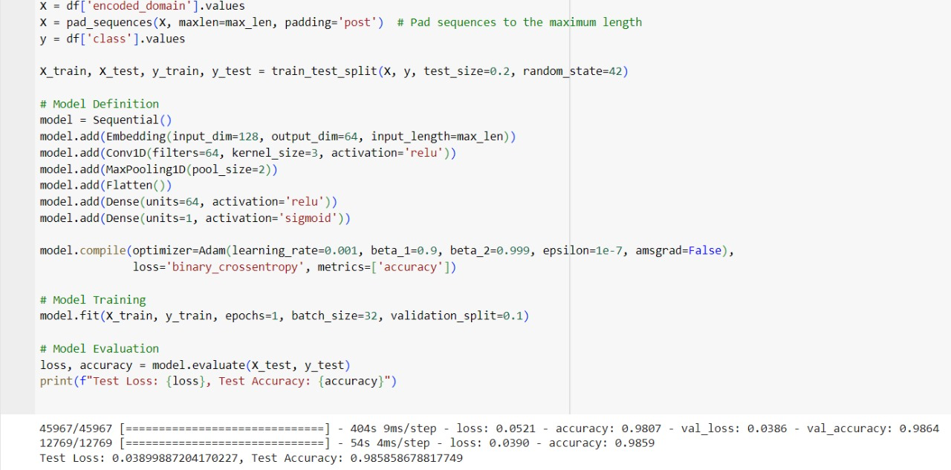
2
ML MODELS TO DETECT DGA
(ii) Implementation of DGA using CNN method
The provided code is a Python script that demonstrates a simple binary classification task using a Convolutional Neural Network (CNN) with domain names as input.

Slide 12
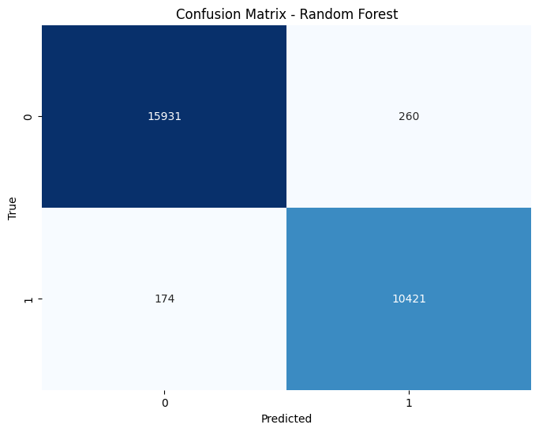
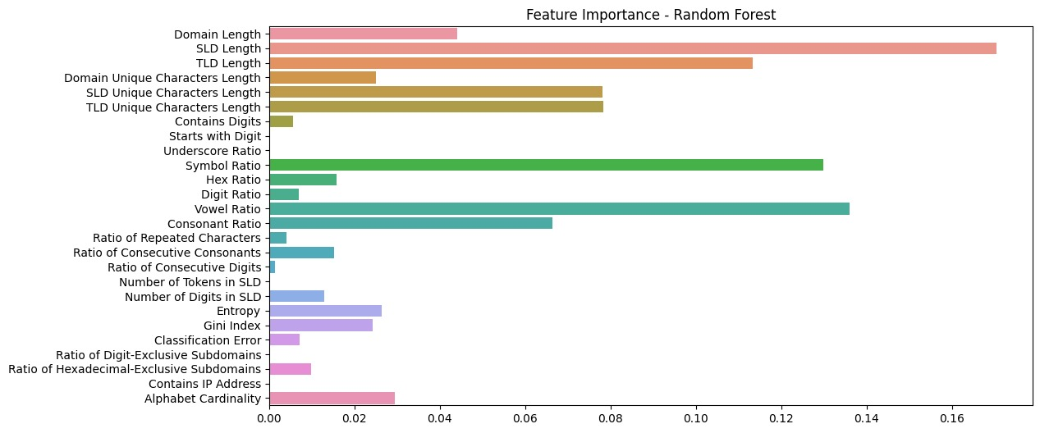
2
ML MODELS TO DETECT DGA
(ii) Implementation of DGA using Random Forest

Slide 13
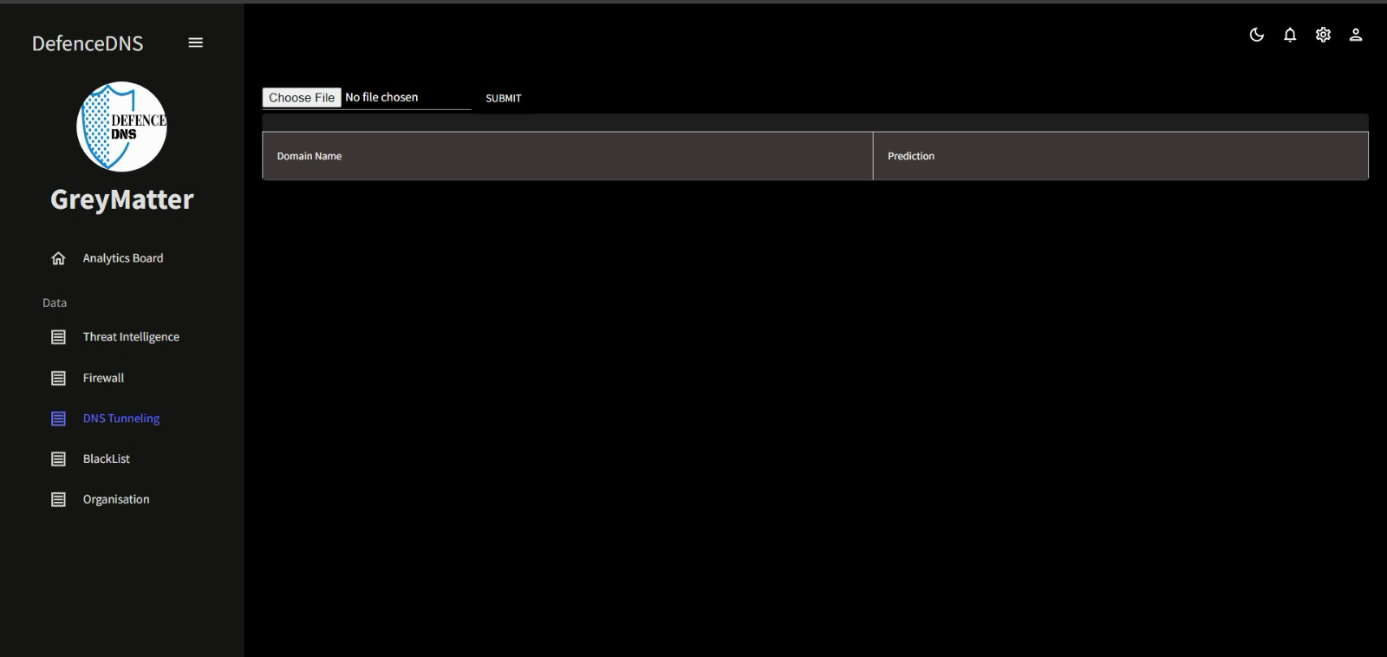
3
DNS TUNNELING DETECTION
ACCURACY 99.1%
POST INCIDENT ANALYSIS

Slide 14
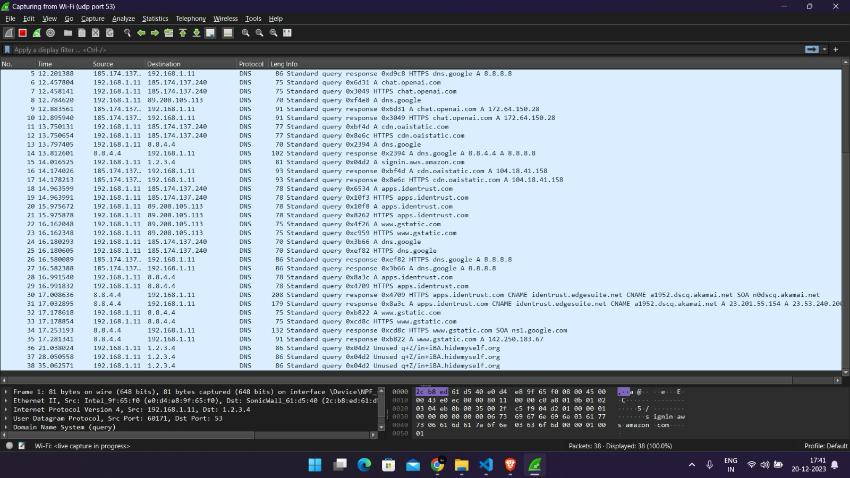
3
DNS TUNNELING DETECTION
ACCURACY 99.1%

Slide 15
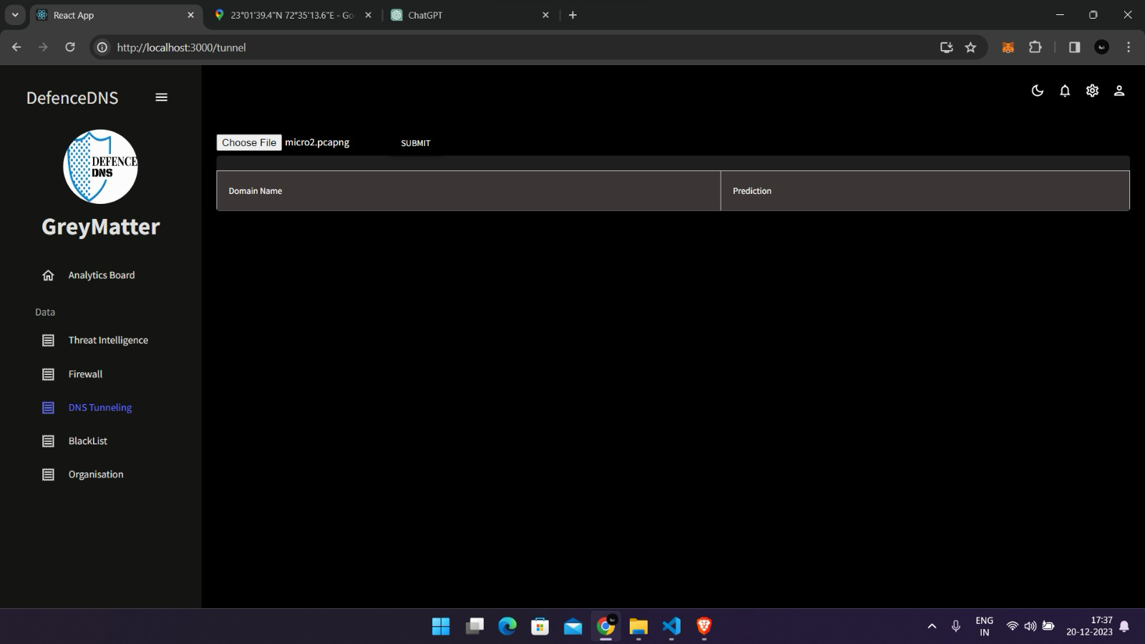
3
DNS TUNNELING DETECTION
ACCURACY 99.1%

Slide 16
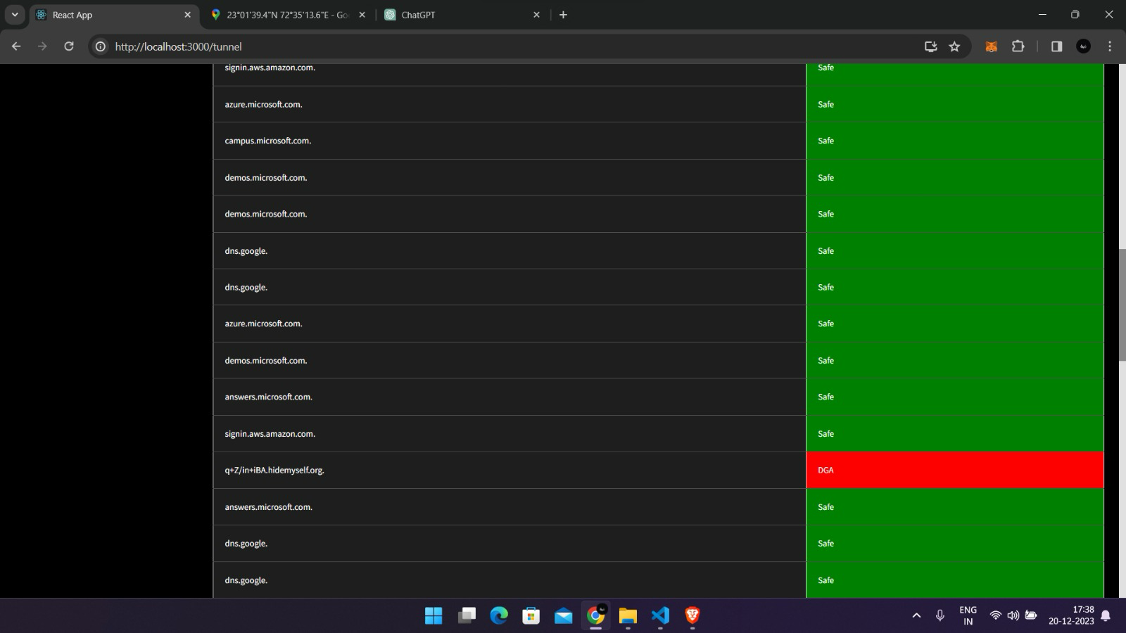
3
DNS TUNNELING DETECTION
ACCURACY 99.1%

Slide 17
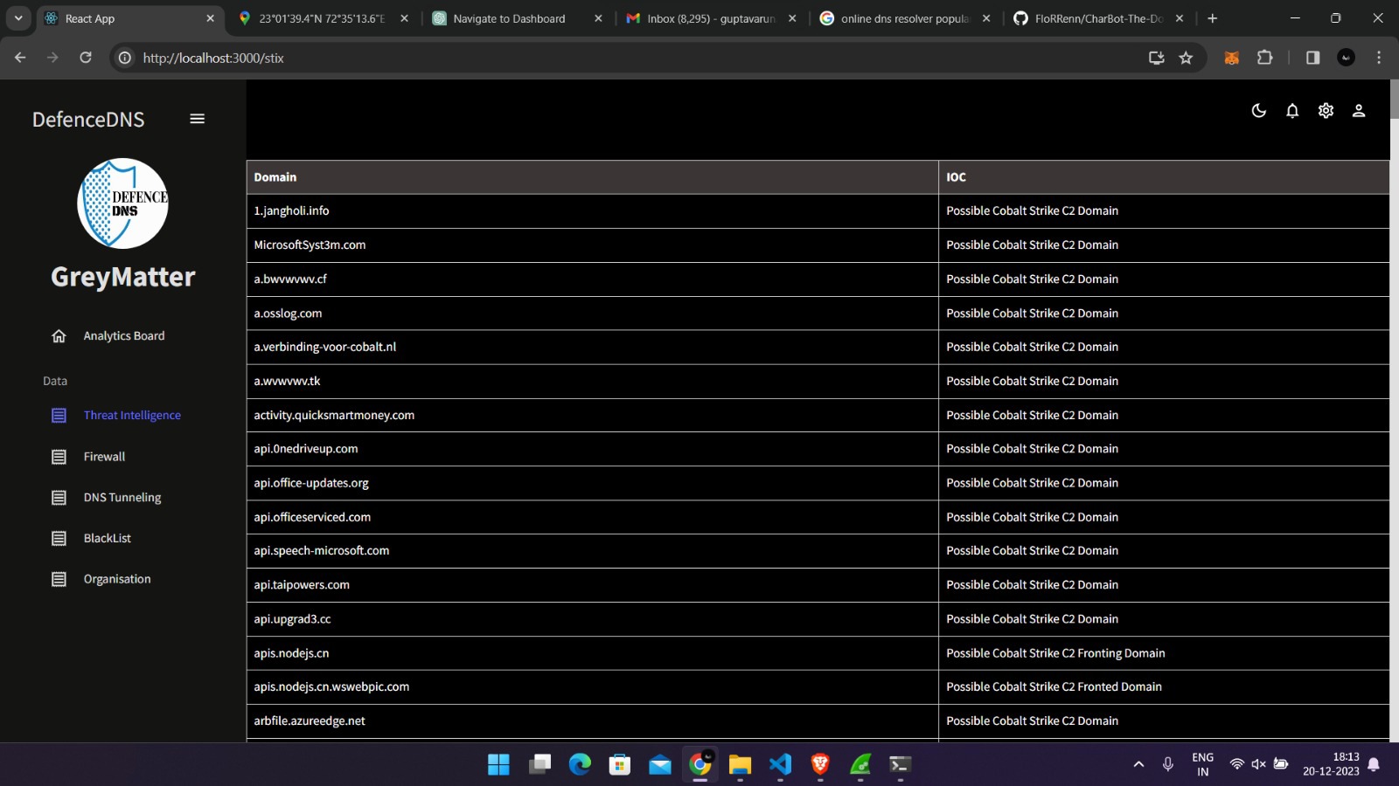
4
STIX-TAXII

Slide 18
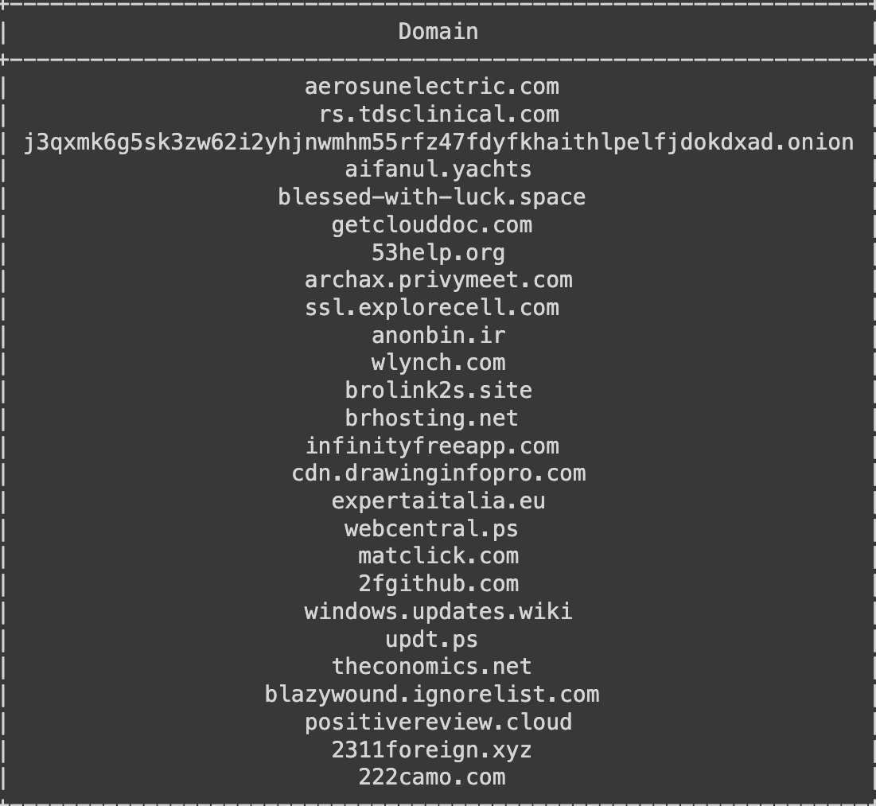
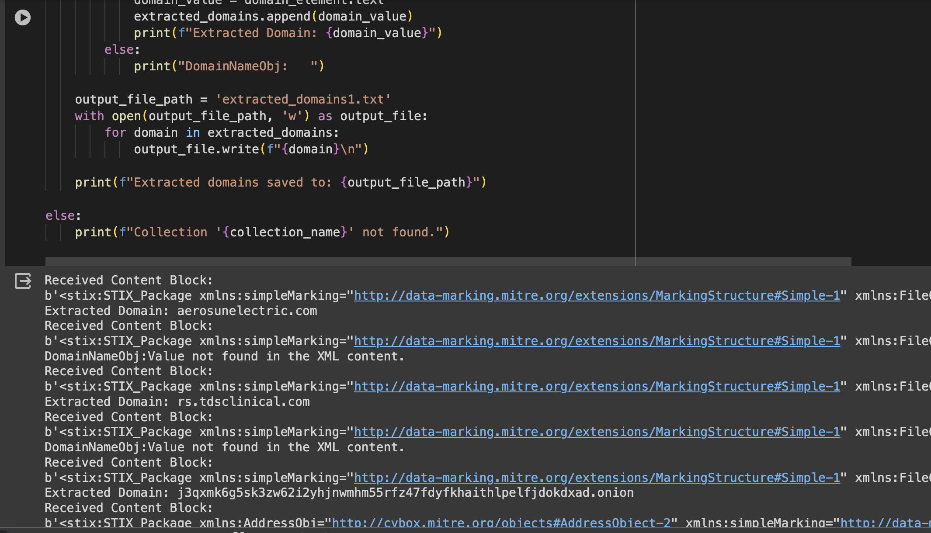
4
STIX-TAXII
Extracted Malicious domains

Slide 19
5
REAL TIME STATISTICS
Our real-time statistics have the following features :-
Queries Resolved
Malicious Domains Detected
DGA (Domain Generation Algorithm) Detection
Customizable Dashboards
Passive DNS Tunneling

Slide 20
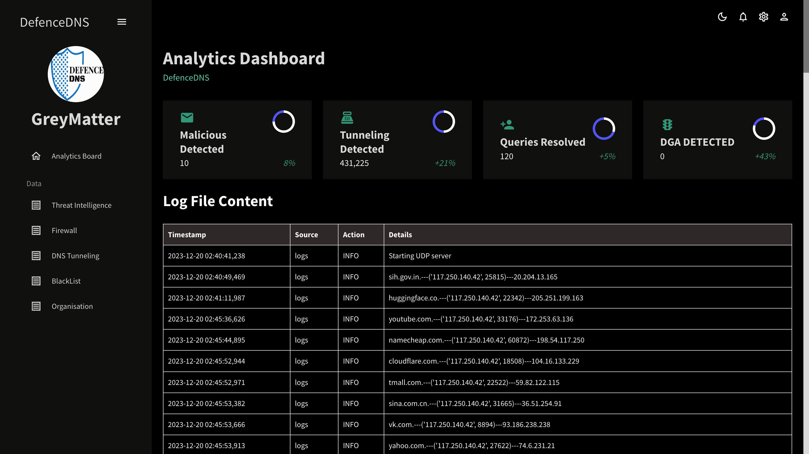
5
REAL TIME STATISTICS

Slide 21
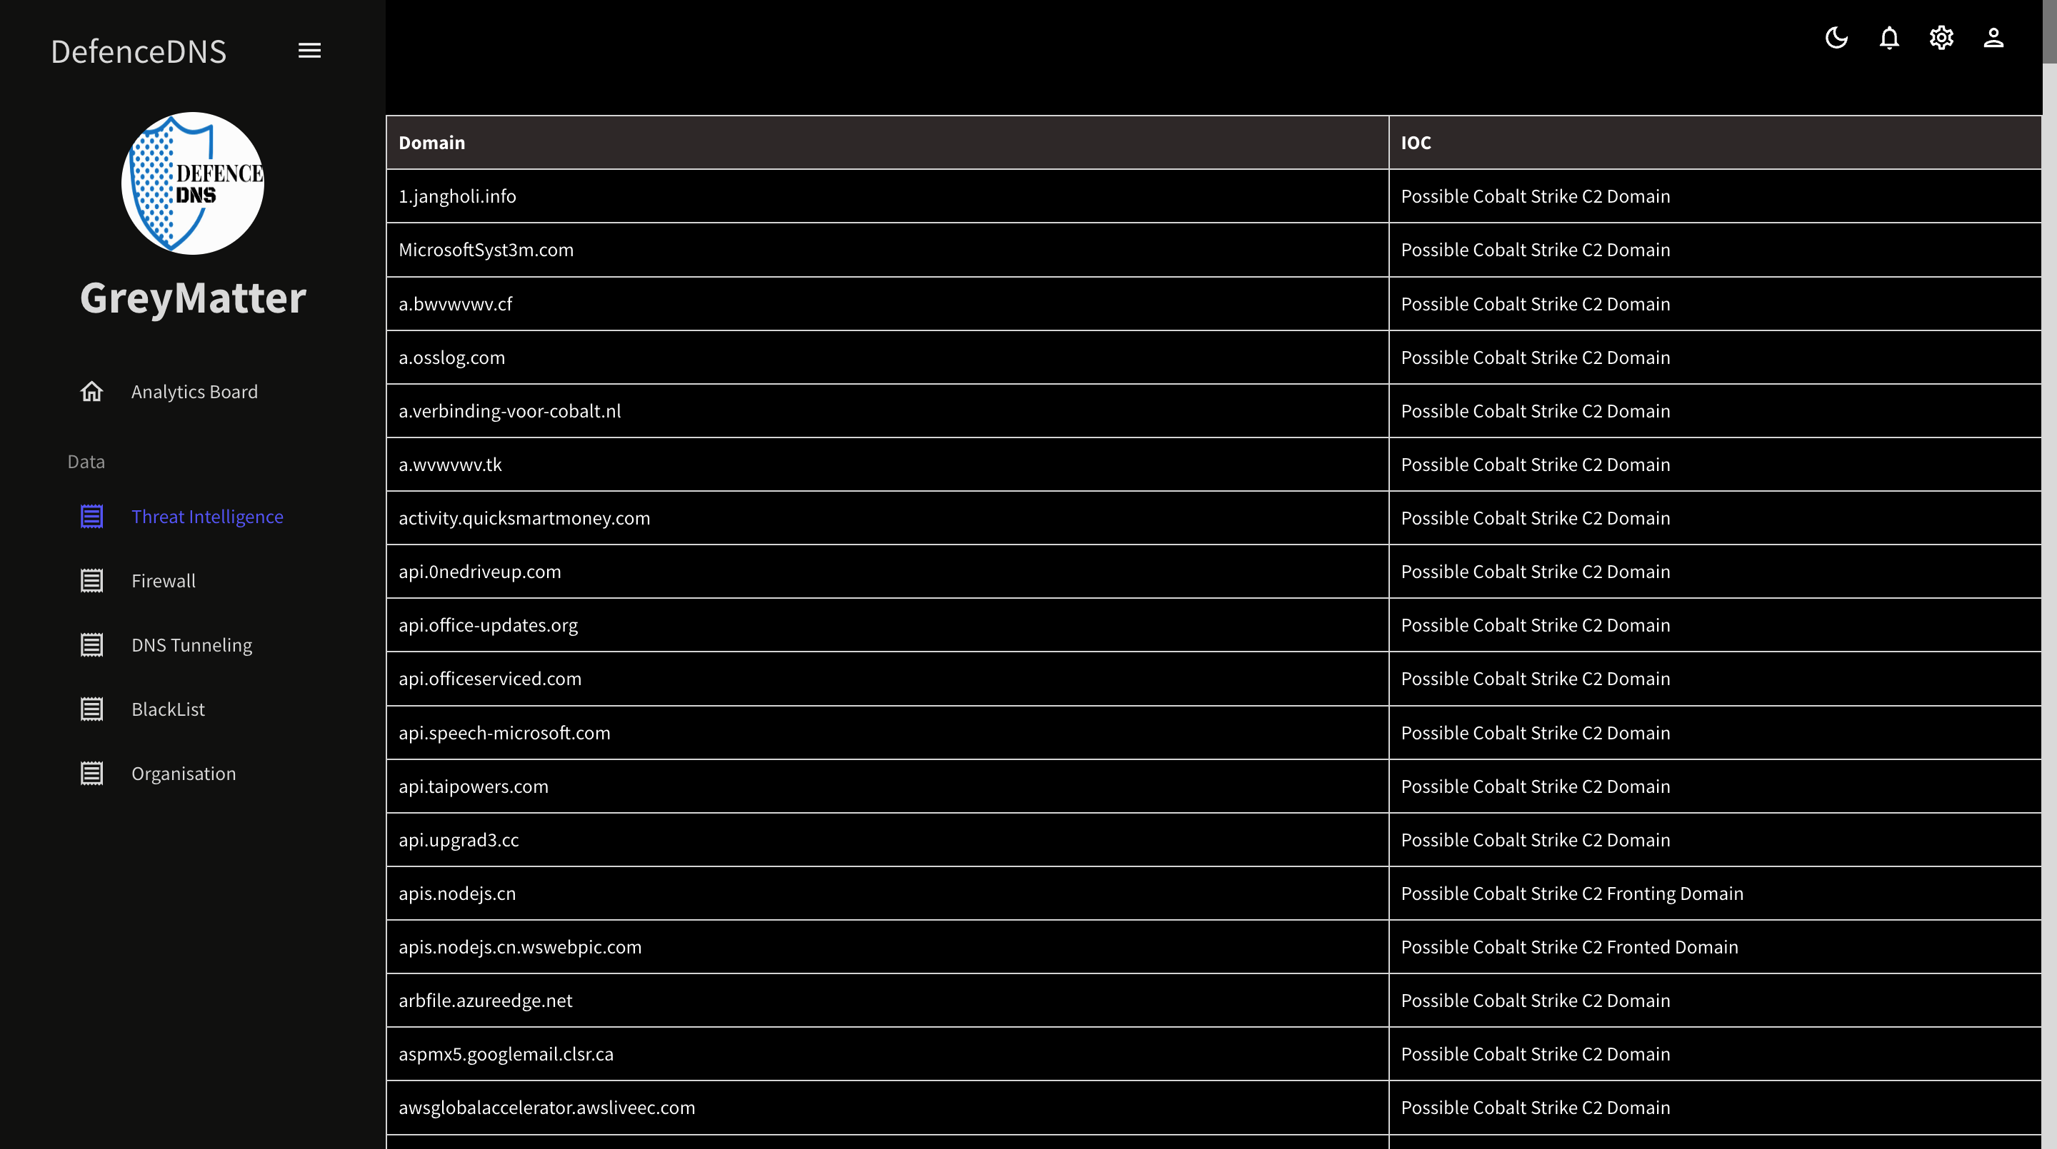
5
REAL TIME STATISTICS

Slide 22
5
REAL TIME STATISTICS

Slide 23
ADDITIONAL FEATURES
Command Line Tool
It is used for bulk lookup.
It is designed in such a way so that it can use many resolvers to resolve the queries parallelly.
It allows parallel querying that allows faster resolution of queries.

Slide 24
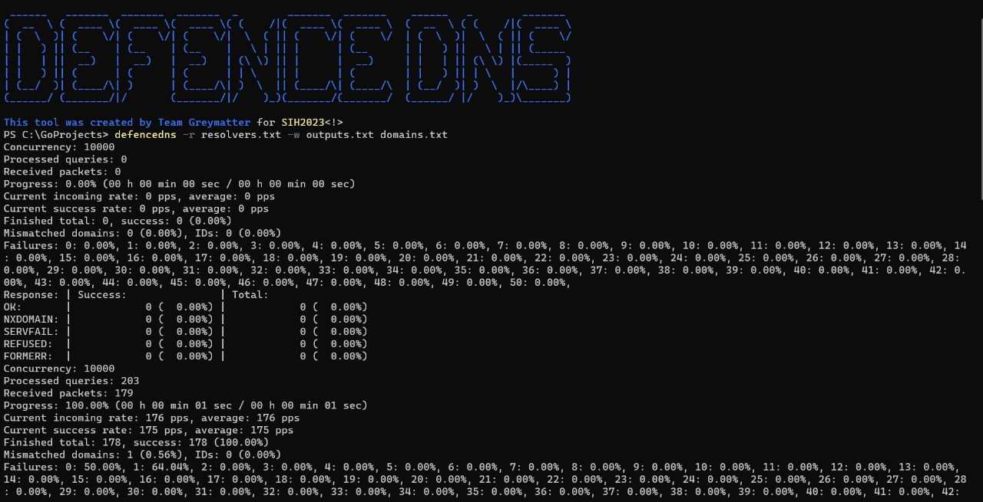
ADDITIONAL FEATURES

Slide 25
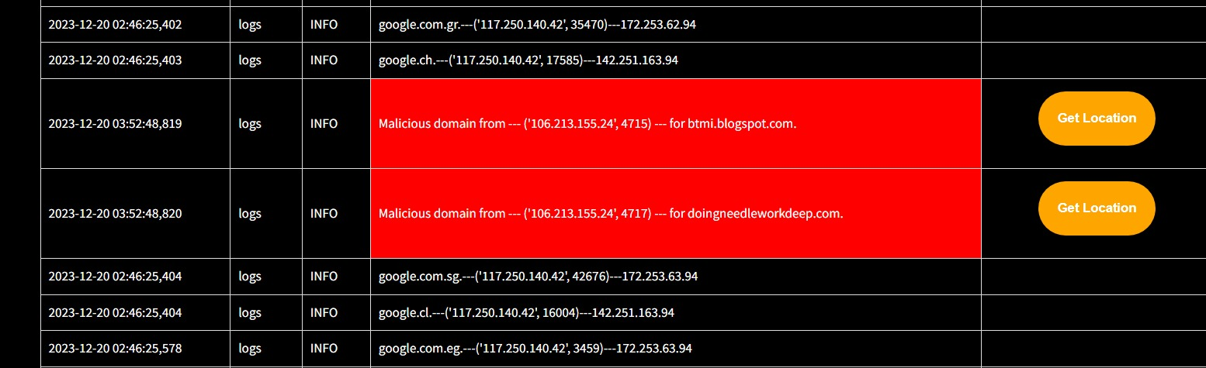
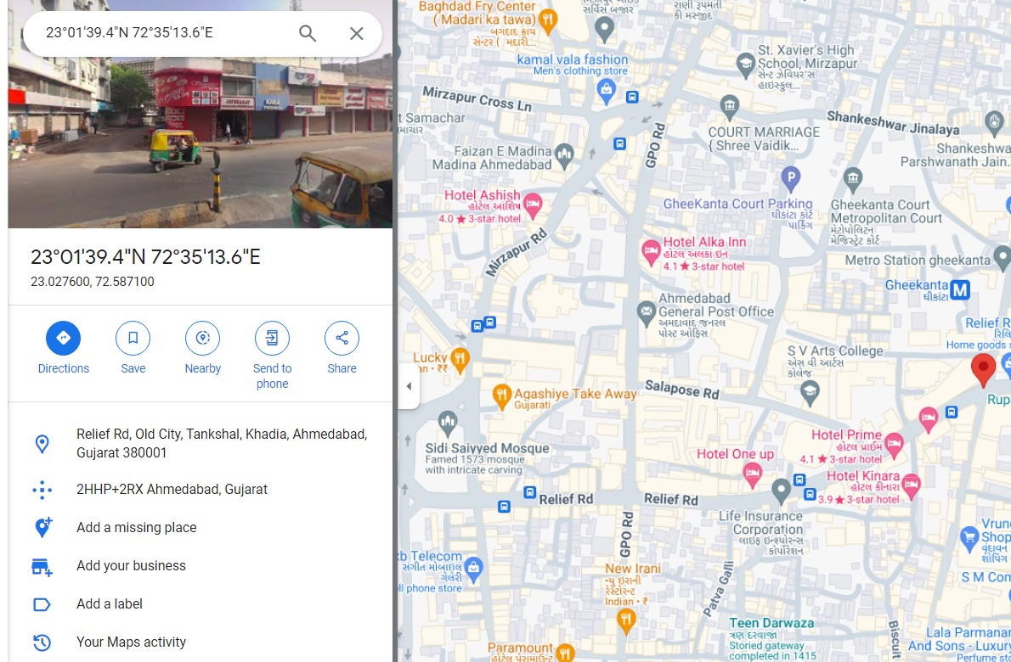
ADDITIONAL FEATURES
Geo-Location Monitoring For Threat Intelligence
Clicking on “Get Location” button leads us to the location of the source query.

Slide 26
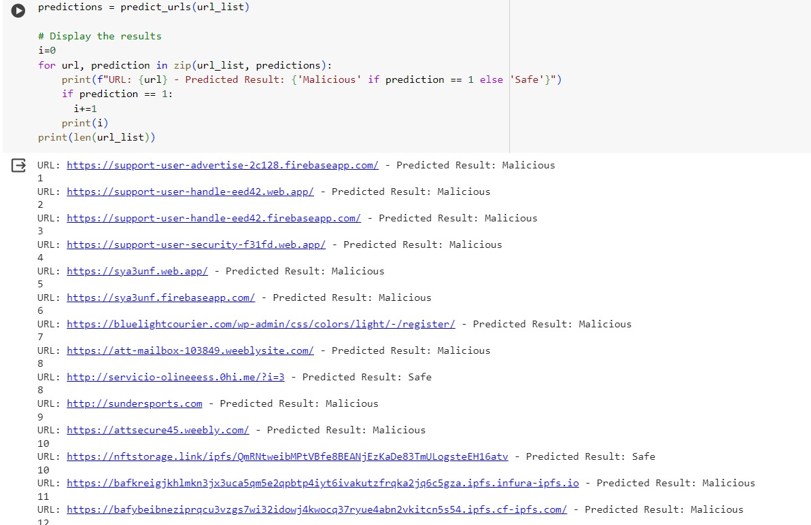
PHISING DETECTION USING CONFUSION MATRIX

Slide 27
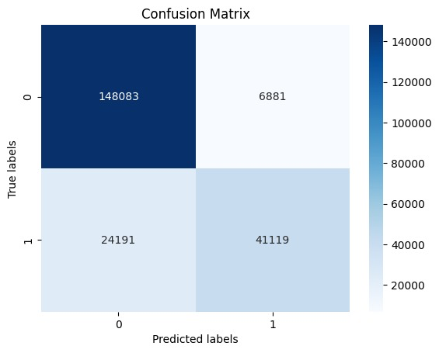
PHISING DETECTION USING CONFUSION MATRIX

Slide 28
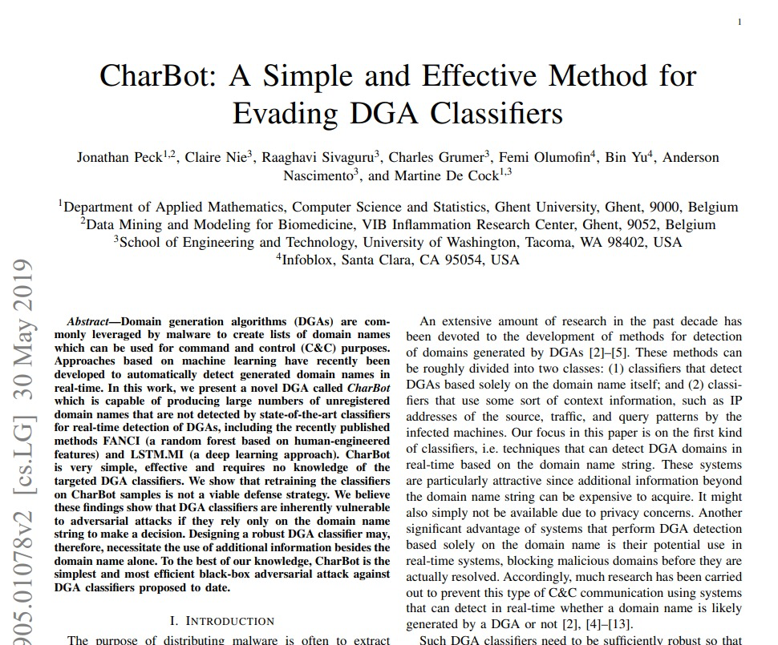
ADDITIONAL FEATURES
CHARBOT
CharBot: The Domain Generation Algorithms (DGA)
This code is implemented based on paper

Slide 29
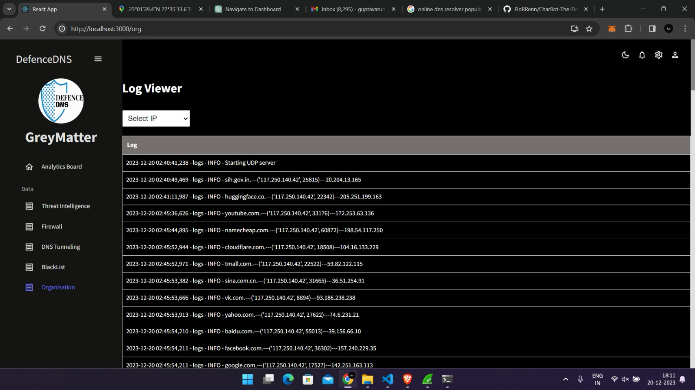
ADDITIONAL FEATURES
Organisation
\

Slide 30
Future Scope of DefenseDNS
Customizable Time-Based Policies
Allow users to set time-based policies, enabling them to restrict or
permit access to certain websites or content during specific hours or days.
Content Filtering and Parental Controls
Provide users with the ability to filter content based on categories (e.g., adult content, gambling, social media) to enhance parental controls and network security.
Quantum-safe DNS
also known as Quantum-resistant DNS, refers to the concept of securing the Domain Name System (DNS) against potential threats posed by quantum computers. Quantum computers have the potential to break widely used cryptographic algorithms, such as RSA and ECC, which are fundamental to the security of many internet protocols, including DNS.
Global Server Network
Establish a global network of DNS servers strategically located to optimize response times, reduce latency, and ensure reliable performance worldwide.

